Slide 1
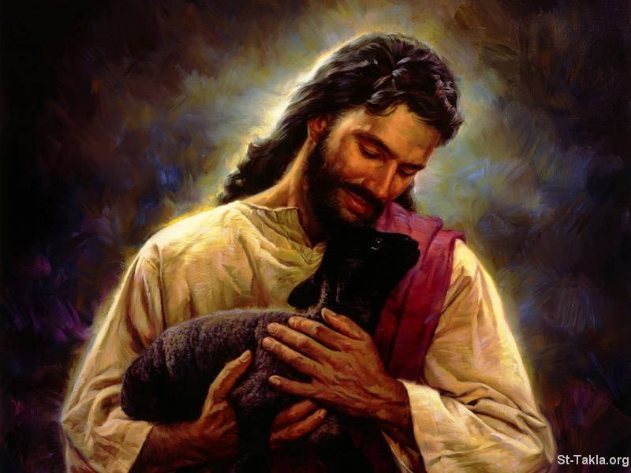
An Invitation for
Returning Catholics
7 Week Series
Begins
April 24th
For more information, Visit
www.stjosephplacentia.org
Or call 714 528-1487 ext 221
Returning Catholics Come Home

